Slide 1

Library System Application
Professor: Bright Gee Varghese R
Students:
Phuong Khanh Nguyen
Huy Toan Nguyen
Van Nhinh Nguyen

Slide 2
Mainpoint
Usecase Diagram
Class Diagram
Sequence Diagram
Demo
Application Architecture

Slide 3
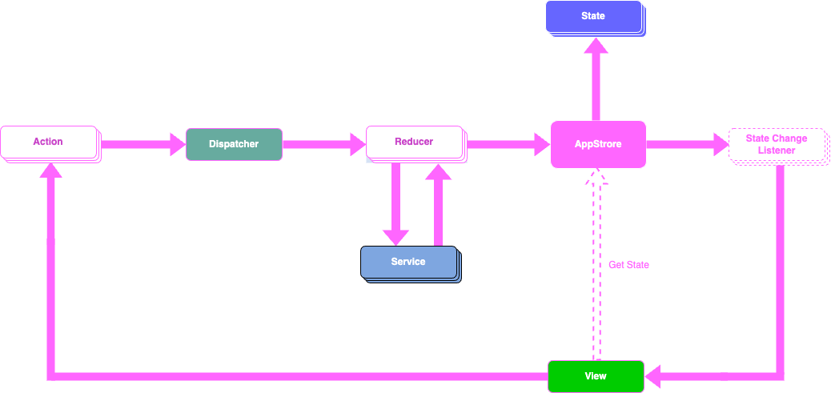
Application Architecture
State Management

Slide 4
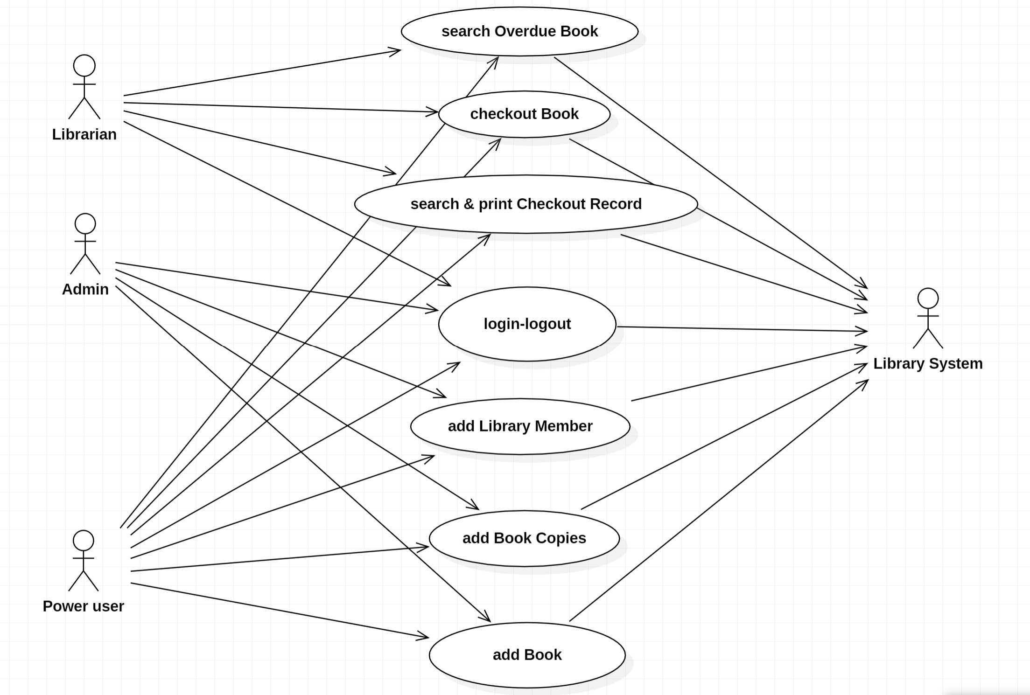
Usecase Diagram

Slide 5
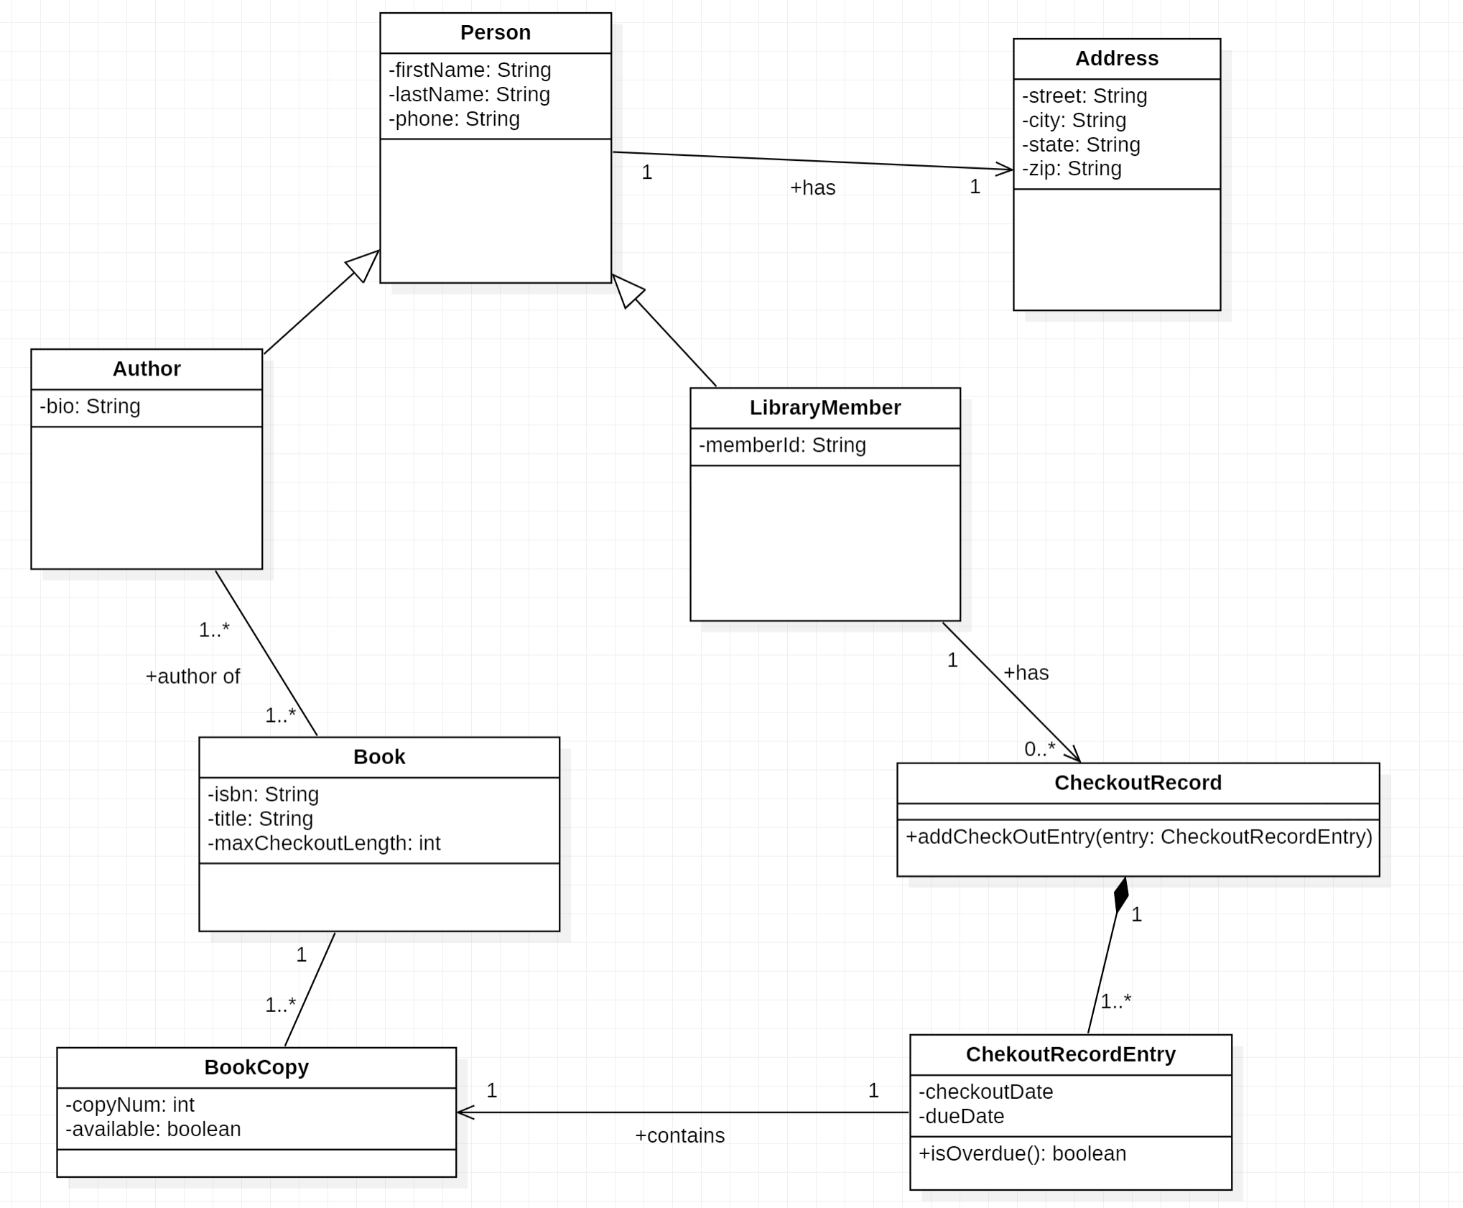
Class Diagram

Slide 6
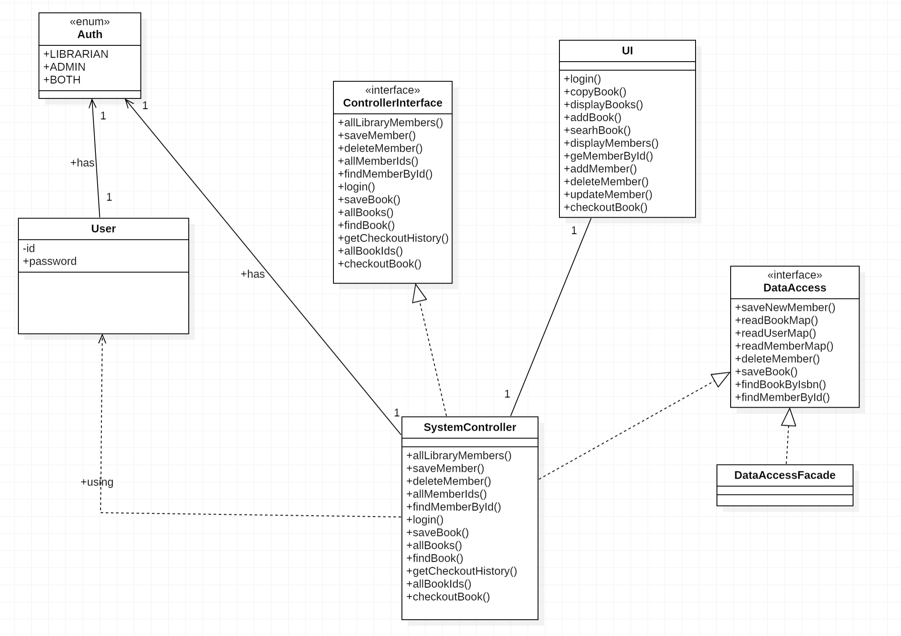
Class Diagram

Slide 7
Usecase Description: Login
User Action​ | System Response​
User enters user credentials and press "Sign In" button | System verifies user credentials and open menu by user role(in case invalid username or password system shows error message)
Sequence Diagram

Slide 8
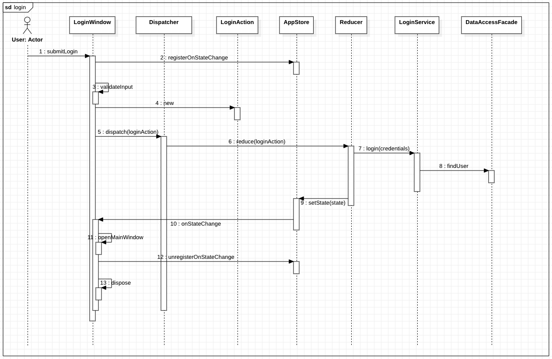
Sequence Diagram

Slide 9
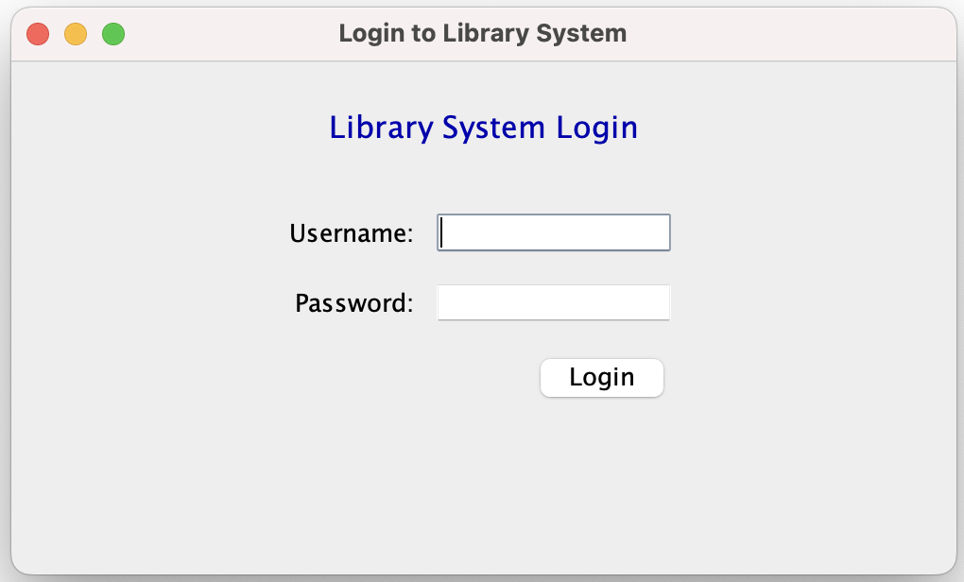
Login Window

Slide 10
Usecase Description: Add Book
User Action | System Response
User clicks on Add book button | System opens the Add Book dialog
User inputs all the fields and clicks on submit button | System validates all the fields, if all the fields are valid then add a new book and close the dialog.
Sequence Diagram

Slide 11
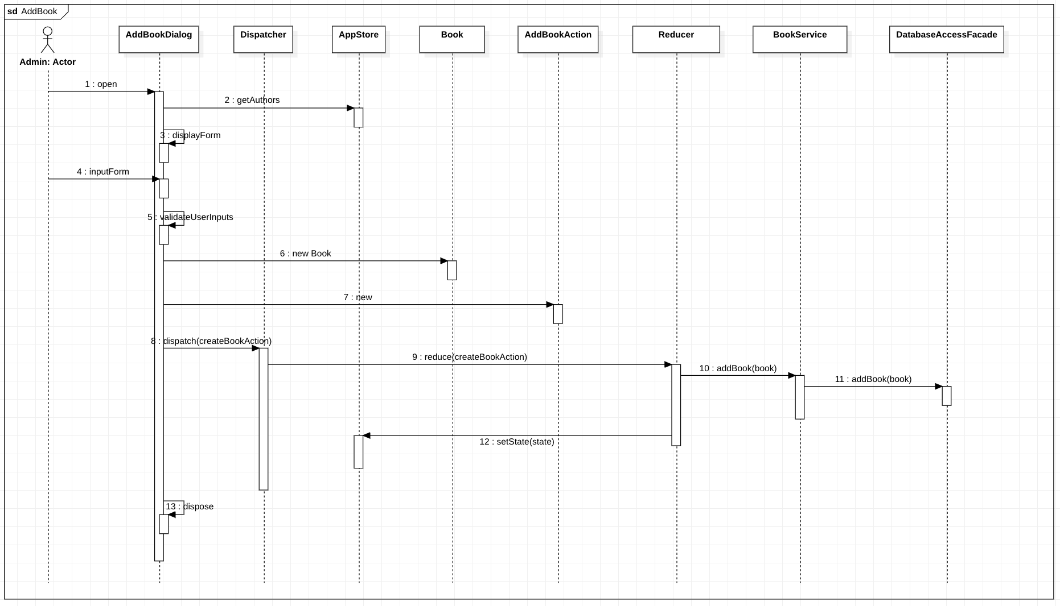
Sequence Diagram

Slide 12
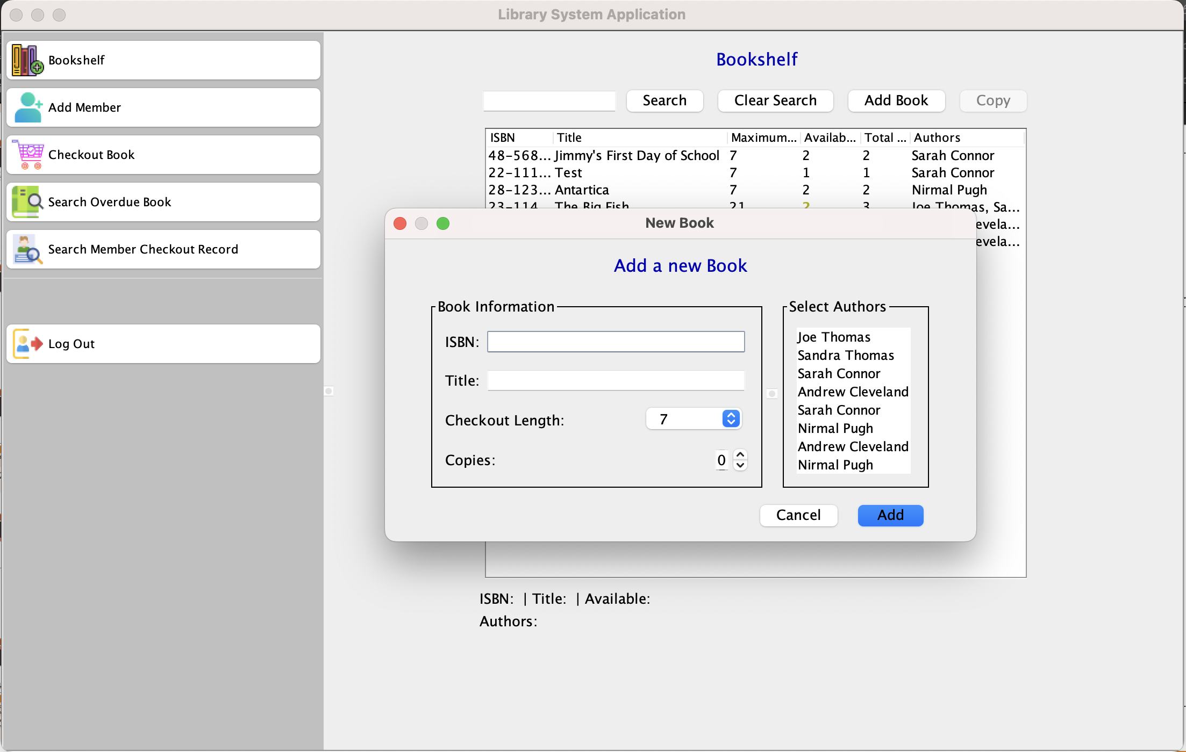
Add Book Dialog

Slide 13
Usecase Description: Checkout Book
User Action | System Response
User select memberID and ISBN in main view | System respond with the list of memberID and ISBN in screen
User click button “Checkout Book” | System validate both member and book copy availability and record the book checkout record and respond with a success message.
Sequence Diagram

Slide 14
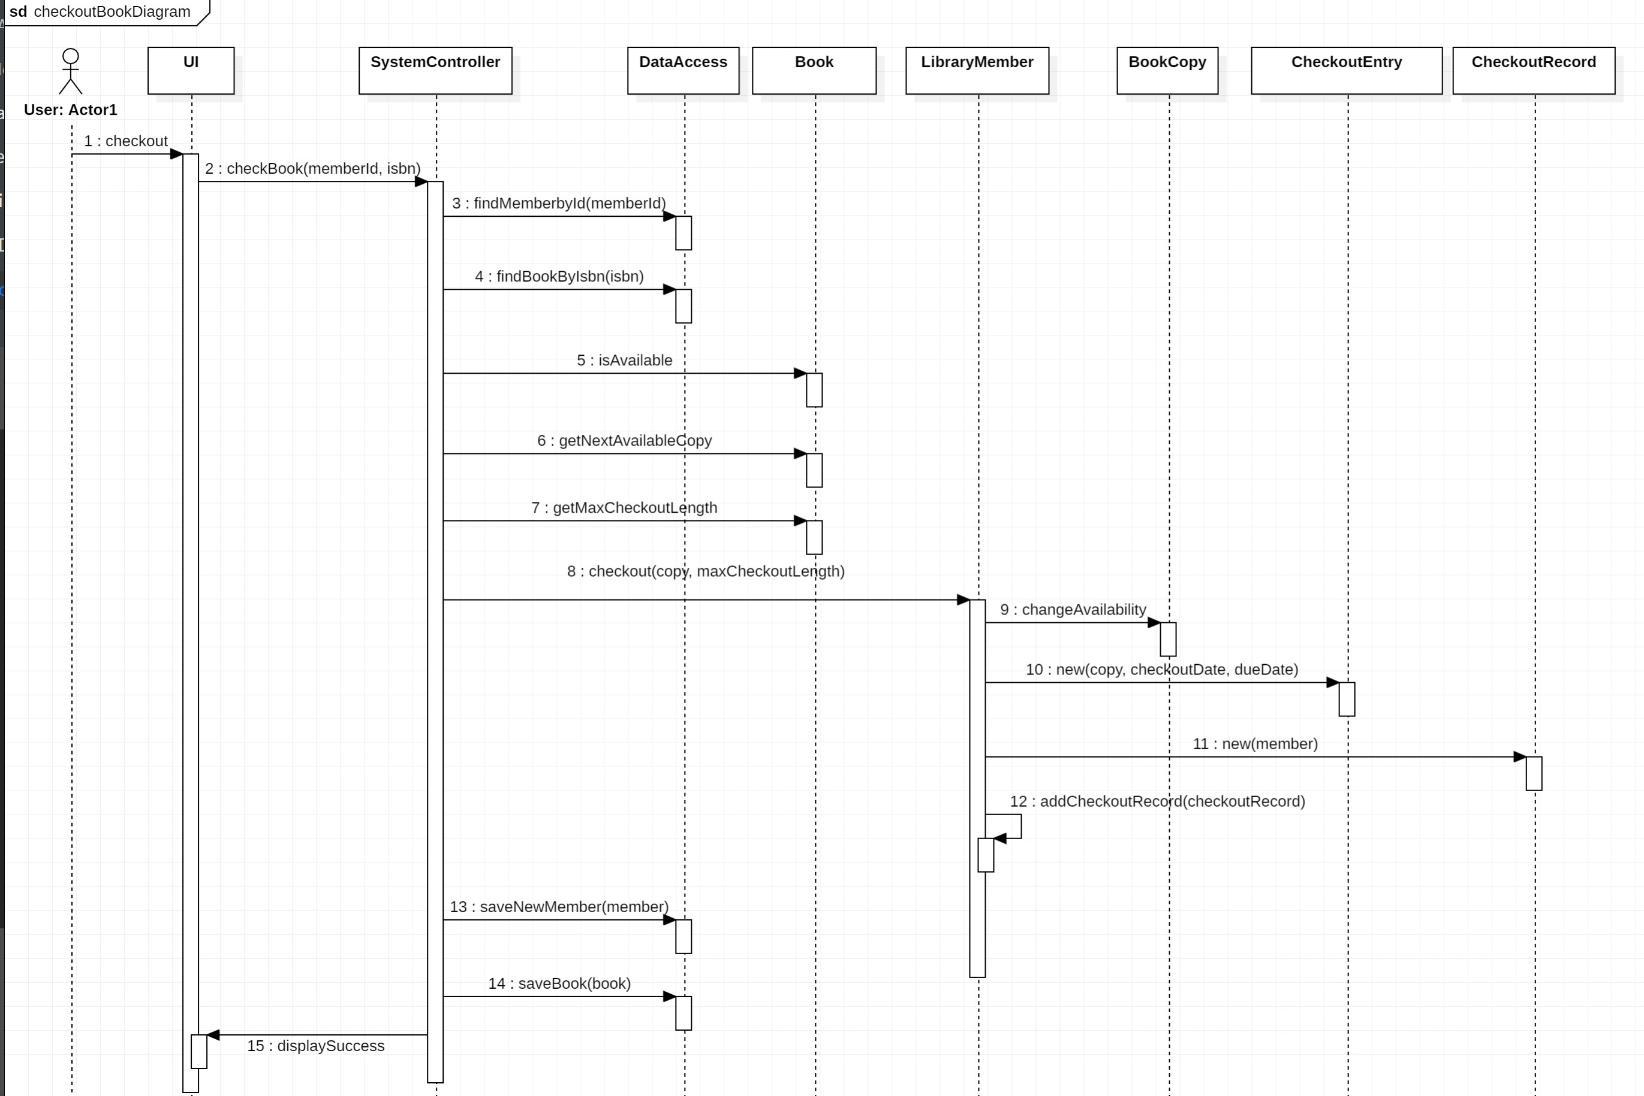
Sequence Diagram

Slide 15
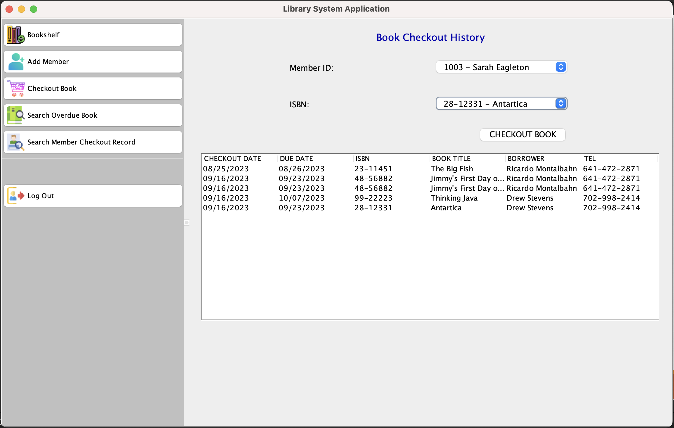
Sequence Diagram

Slide 16
Usecase Desciption: Print checkout records
User Action​ | System Response​
User enter memberId to search for | System check if that member exists & populate member details
User click “Print” button | System looks for all checkout record entries & they appear in the console with aligned columns
Sequence Diagram

Slide 17
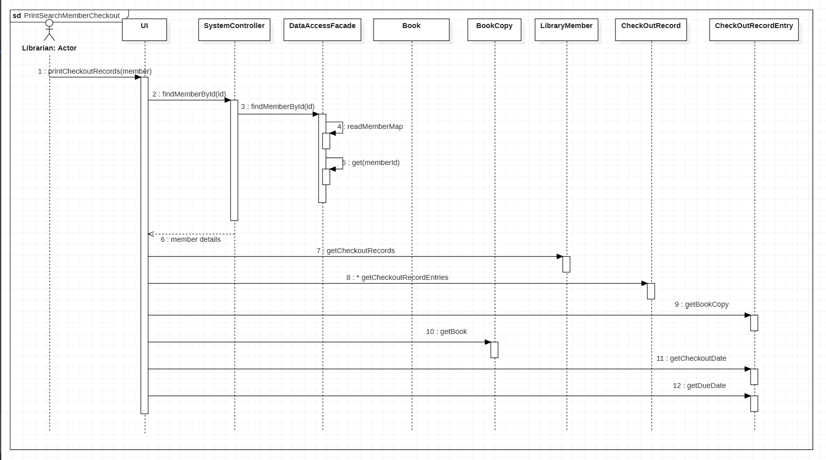
Sequence Diagram

Slide 18
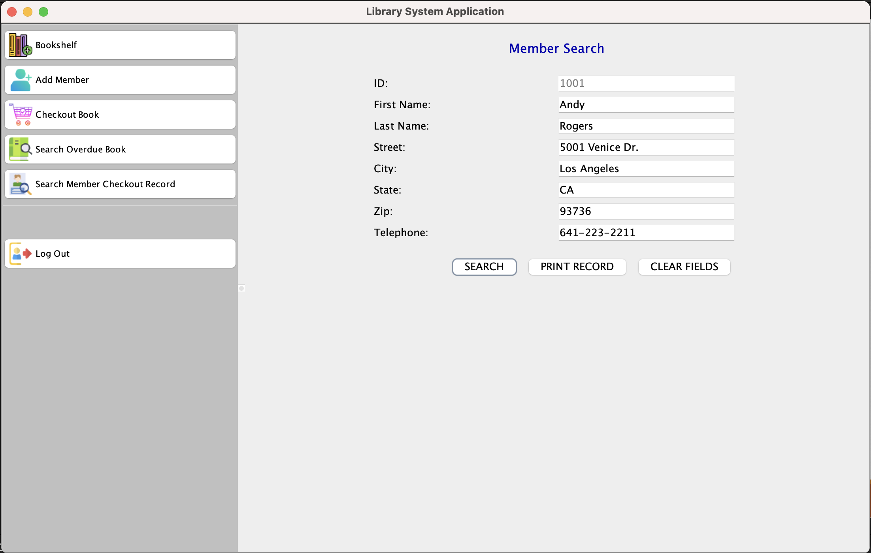
Sequence Diagram

Slide 19
Demo
Demo

Slide 20

Thank you

